Slide 1
Containers, Cloud Native Computing, DevOps
Oxford University
Software Engineering Programme
January 2018

Slide 2
Contents
Containers
History and Approach
Docker
Docker ecosystem
PaaS in a container model
Futures

Slide 3
Sharing of resources vs Isolation
Dedicated data centre
Dedicated HW/ Shared Datacentre
More isolation
Virtual Machines
Containers
Shared OS Separate processes
Shared
Process
Better resource utilisation

Slide 4
Lightweight Virtualization history
zSystems Virtual Servers from late 1990s
(the mainframe really did do everything first)
Solaris Containers
AIX Workload Partitions
FreeBSD Jail
…

Slide 5
What is a Container?
A lightweight virtual server
Running within an Operating System
Providing various levels of isolation and control
E.g. Disk isolation and control
Network isolation
CPU and memory controls

Slide 6
Containers at Google
Every GMail session is a container
Try doing an export and then searching your email ☺
“Everything runs in a container”
2 billion containers launched a week
Borg
Any Google developer can instantiate their code in 10,000 instances any time they want
Takes about 5 minutes to start that many
Never exactly 10,000 because of failures

Slide 7
Linux Containers (LXC)
Virtualization inside the Linux Operating System
Not the only Linux option, but the most popular
Allows virtualization including CPU, memory, disk
Simple and effective

Slide 8
A sample of LXC
apt-get install lxc
lxc-create -t ubuntu -n cn-01
lxc-start –n cn-01
lxc-console –n cn-01
lxc-freeze –n cn-01

Slide 9
cgroups
Control of resources by process:
blkio — this subsystem sets limits block devices such as physical drives
cpu - access to the CPU.
cpuacct — this reports on CPU usage
cpuset — this controls usage by CPUs in a multicore
devices — this denies or grants access to devices
freezer — suspends and resumes tasks
memory — controls and reports on memory usage
net_cls — tags network packets with ids for control
net_prio — priority of network traffic per interface.
ns — the namespace subsystem.

Slide 10
Alternatives to LXC
xhyve – OS/X
bhyve – BSD containers
rkt – CoreOS Rocket (aiming at Docker)

Slide 11
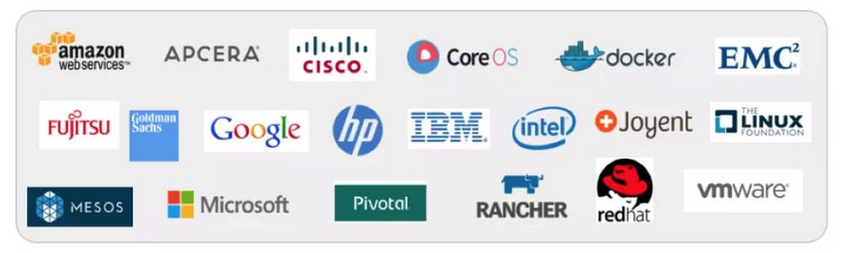
libcontainer and the Open Container Foundation
A standardised interface into the container layer
Part of runC the open runtime from Docker
A key basis of the Open Container Foundation

Slide 12
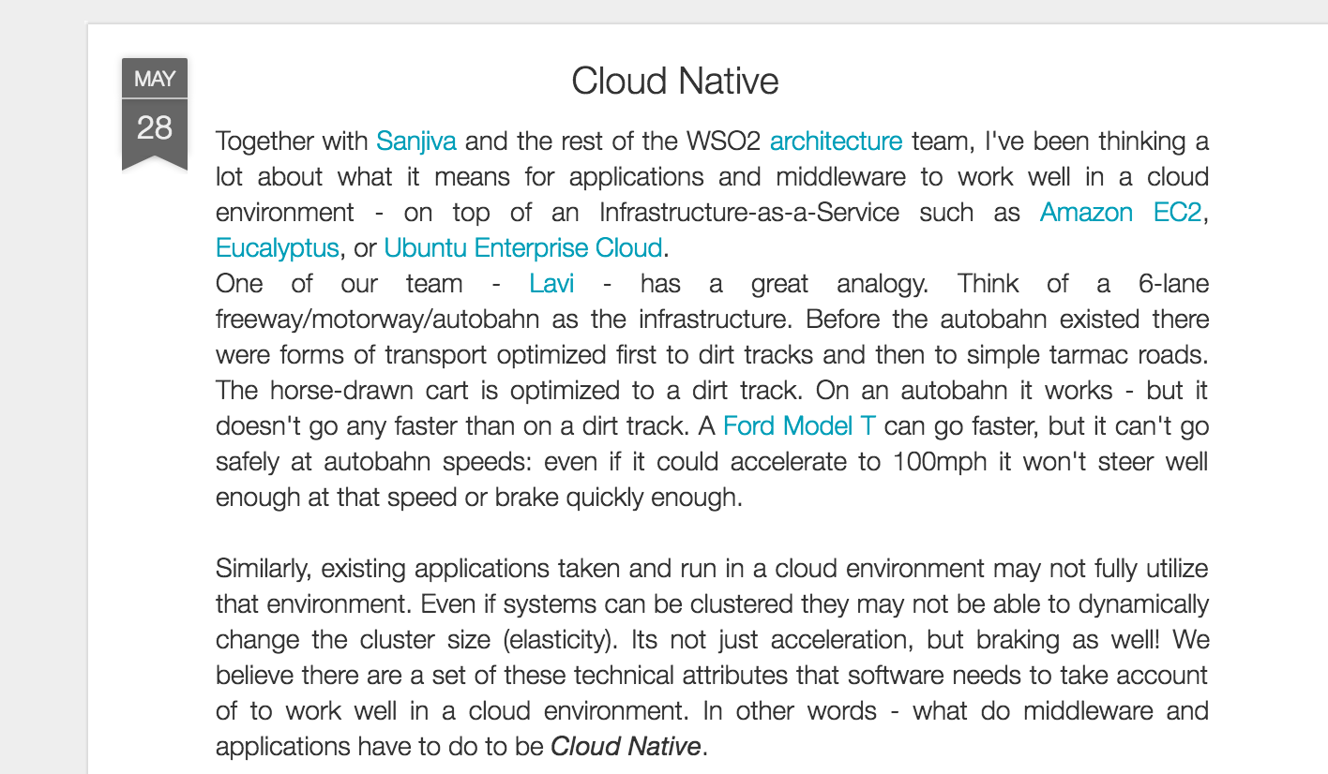
Cloud Native

Slide 13

Cloud Native Computing Foundation
A new definition of “Cloud Native”
Container Packaged
Dynamically Managed
Micro-Service oriented

Slide 14
Docker on top of LXC
Docker adds several things to LXC and containerization:
Copy on write filesystem
Layered images and the ability to extend machines easily
Simple textual config file
Portable deployment across machines
Creating an ecosystem of images
Application centric
Each VM is a process (roughly speaking)
Plus others (auto-build, etc)

Slide 15
Why Docker?
The ecosystem has created a network effect
Metcalfe’s Law states
the value of a telecommunications network is proportional to the square of the number of connected users of the system
There is surely a corollary for ecosystems

Slide 16

How does Docker work?

Slide 17
Some simple Docker commands
apt-get install docker.io
docker pull ubuntu
docker run –t –i ubuntu /bin/bash
docker ps
docker commit funky_freo image
docker push image

Slide 18

DevOps

Slide 19
DevOps
DevOps is the codification of the interface between Development and Operations
Agile
Repeatable
Collaborative
Versioned
Automated

Slide 20
Cloud and DevOps
It could be argued strongly that the rise of DevOps is tied to the rise of Cloud
Clear requirement for automated, repeatable configuration and deployment
Reducing the hardware provisioning time has highlighted the challenges

Slide 21


Kittens vs Cattle (An unpleasant but effective analogy)

Slide 22
Immutable objects
String in Java
You can’t change a String, only create a new one
Applies to devops:
Never change a running server
Only create a new one that is better
Track the changes in a version control model

Slide 23

Blue Green Deployment
http://martinfowler.com/bliki/BlueGreenDeployment.html

Slide 24
DevOps tools
Puppet, Chef
Automated configuration and deployment tools
Allow complex infrastructures to be re-configured automatically
Vagrant
Create VMs instantly
Plus many many more!

Slide 25
DevOps and Docker
Docker is a key DevOps tool
Speeds up the creation of repeatable deployments
Consistency between development, test and production
Versioned repository
Works with Chef, Puppet, etc

Slide 26
Challenges with Docker and Solutions
Networking
It is very complex to connect different containers, even on a single machine
Weave Networks
SocketPlane (bought by Docker)
Clustering
Docker Swarm
Google Kubernetes
CoreOS
Apache Mesos
Lack of mutable file system
Flocker

Slide 27
Docker Machine
A useful tool for creating and managing docker host machines
Works with swarm
Adapters for AWS, DigitalOcean, VirtualBox, vmWare, etc

Slide 28

Docker Compose
How to create a set of containers that work together

Slide 29

Kubernetes
Open Source cluster management of containers
From Google, but separate from the Borg project
Now donated to the CNCF

Slide 30
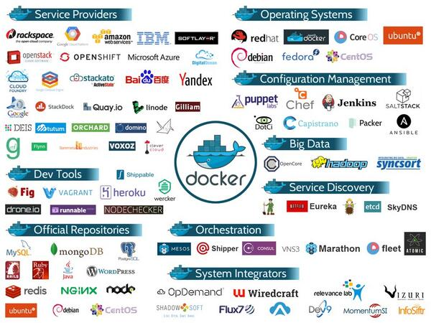
Docker ecosystem

Slide 31

http://12factor.net

Slide 32
12 Factor Apps
Codebase
One codebase in revision control, many deploys
Dependencies
Explicity define and declare
Config
Store config in the environment
Backing Services
Treat as attached resources
Build, Release, Run
Strictly separate
Processes
Execute the app as stateless processes
Port Binding
Export services via port binding
Concurrency
Scale out via processes
Disposability
Fast startup and graceful shutdown
Dev/Prod Parity
Keep dev/staging/prod as similar as possible
Logs
Treat logs as event streams
Admin Processes
Run admin/mgmt tasks as one-off processes

Slide 33
Summary
Docker and the Container model
Lightweight virtualization and repeatability
Blue Green deployment
“Warehouse Scale” computing

